Slide 1
DNA Variant Calling by Current-Generation Sequencing
John Didion, PhD

Slide 2
DNA Variant Calling by Current-Generation Sequencing
OUTLINE
Discussion of experimental design
Overview/refresher of sequencing technology
Hands-on, step-by-step walkthrough of variant-calling workflow
Troubleshooting and evaluation

Slide 3
DNA Variant Calling by Current-Generation Sequencing
NOT COVERED
Microarrays
Metagenomics (i.e. microbial communities)
RNA (e.g. mRNA-seq, miRNA-seq)
Single-cell methods

Slide 4
DNA Variant Calling by Current-Generation Sequencing
OBJECTIVES
Understand key features of sequencing experiments that influence data analysis and interpretation
Be comfortable using the command line to run all steps of the workflow
Be aware of potential pitfalls

Slide 5
APPLICATIONS OF VARIANT CALLING
Clinical
Screening
Diagnosis
Precision medicine (e.g. pharmacogenetics)
Research
Gene/trait mapping (GWAS)
Cancer (somatic mutations)
Molecular epidemiology
Population/evolutionary genetics

Slide 6
VARIANT CALLING WORKFLOW
Experimental design
Library preparation and Sequencing
Data quality
Trimming
Alignment
Variant calling and filtering
Annotation
Structural variants (SVs)

Slide 7
VARIANT CALLING WORKFLOW
Experimental design
Library preparation and Sequencing
Data quality
Trimming
Alignment
Variant calling and filtering
Annotation
Structural variants (SVs)

Slide 8
EXPERIMENTAL DESIGN
Key Considerations
Genome status: existing reference or de novo?
Target: whole genome, exome, or specific region(s)?
Target size: large (e.g. human, mouse genome) or small (e.g. bacteria, virus)?
Sample size
Mutation types and frequencies
Acceptable discovery rate (i.e. sensitivity)

Slide 9
EXPERIMENTAL DESIGN
Questions to Answer
How many replicates?
What sequencing technology to use?
How to prepare the sequencing libraries?
How deeply to sequence?
What is my budget?

Slide 10
EXPERIMENTAL DESIGN
How much will it cost?
N = Number of Samples
L = Library preparation cost
S = Cost per unit of sequencing
D = Depth (or “coverage”) per sample
B = Bioinformatics cost per sample
Depth (D) = data size (bp) / genome size
Cost = N * [ L + (S * D) + B ]

Slide 11
EXPERIMENTAL DESIGN
Caveats
Typically, total sequencing depth (N * D) must equal a fixed increment
The “usable” data you will get is only a fraction of D (the theoretical maximum)
On a per-library basis, L, S, and B are often significantly lower for large versus small experiments
Recommendation: make friends with your sequencing core director!
N = Number of Samples
L = Library preparation cost
S = Cost per unit of sequencing
D = Depth of sequencing per sample
B = Bioinformatics

Slide 12
EXPERIMENTAL DESIGN
Key Considerations
Organism genome status: existing reference or de novo?
Target: whole genome, exome, or specific region(s)?
Target size: large (e.g. human, mouse genome) or small (e.g. bacteria, virus)?
Sample size
Mutation types and frequencies
Acceptable discovery rate (i.e. sensitivity)

Slide 13
EXPERIMENTAL DESIGN
Alignment versus Assembly
Alignment: Identifying the mostly likely reference genome coordinate of origin for the sequences generated from your sample
Assembly: Create a genome de novo by stitching together the sequences generated from your sample

Slide 14
EXPERIMENTAL DESIGN
Alignment versus Assembly
Alignment
Requires less sequencing (both depth and read sizes)
Easier and faster bioinformatic analysis
Requires a “finished” reference genome
May miss larger structural variants
Assembly
Often the best (and sometimes only) option for non-model organisms
Requires (costly) deep sequencing with long reads
Assembly is complicated and time-consuming; often several rounds of sequencing are required to “finish” the genome
Hybrid strategies can provide benefits of both approaches

Slide 15
EXPERIMENTAL DESIGN
Key Considerations
Organism genome status: existing reference or de novo?
Target: whole genome, exome, or specific region(s)?
Target size: large (e.g. human, mouse genome) or small (e.g. bacteria, virus)?
Sample size
Mutation types and frequencies
Acceptable discovery rate (i.e. sensitivity)

Slide 16
EXPERIMENTAL DESIGN
Whole-genome versus Targeted
Whole genome sequencing minimizes bias at the expense of greater overall sequencing cost
Targeted sequencing (exome, amplicon) is typically less expensive overall, but don’t forget the cost of sequence capture
In terms of cost-per-base, WES is ~5x more expensive than WGS

Slide 17
EXPERIMENTAL DESIGN
Whole-genome versus Targeted
Targeted sequencing introduces several sources of bias:
Capture efficiency
PCR amplification (CG bias, size bias, errors)*
Reference bias (unless you use a carefully designed custom capture library)
Coverage non-uniformity
* Can also affect WGS, depending on library preparation method

Slide 18
EXPERIMENTAL DESIGN
Whole-genome versus Targeted
General guidelines
For small genomes and/or genome assembly: deep whole-genome
For a small number of known regions: amplicon
For many genes, a known Mendelian trait, and/or potentially rare coding mutations: exome
Otherwise: whole-genome

Slide 19
EXPERIMENTAL DESIGN
Key Considerations
Organism genome status: existing reference or de novo?
Target: whole genome, exome, or specific region(s)?
Target size: large (e.g. human, mouse genome) or small (e.g. bacteria, virus)?
Sample size
Mutation types and frequencies
Acceptable discovery rate (i.e. sensitivity)

Slide 20
EXPERIMENTAL DESIGN
Sample Size versus Sequencing Depth
Most important and most difficult decision
How rare are your variants of interest within the population being studied?
How difficult is it to confidently detect variants?
For population studies (e.g. GWAS), larger sample is usually better than greater depth
Power analysis is key: is your sample large enough to make the study worthwhile?
Remember: you can always re-sequence, or follow up with targeted validation

Slide 21
EXPERIMENTAL DESIGN
Sample Size versus Sequencing Depth
For variant calling in individual humans, the general recommendation is:
20-60x WGS
80-120x WES
For population studies of common variants, coverage as low as 0.5x can yield recall rates of 0.8 or more (“genotyping by sequencing”)

Slide 22
VARIANT CALLING WORKFLOW
Experimental design
Library preparation and Sequencing
Data quality
Trimming
Alignment
Variant calling
Annotation
Structural variants (SVs)

Slide 23
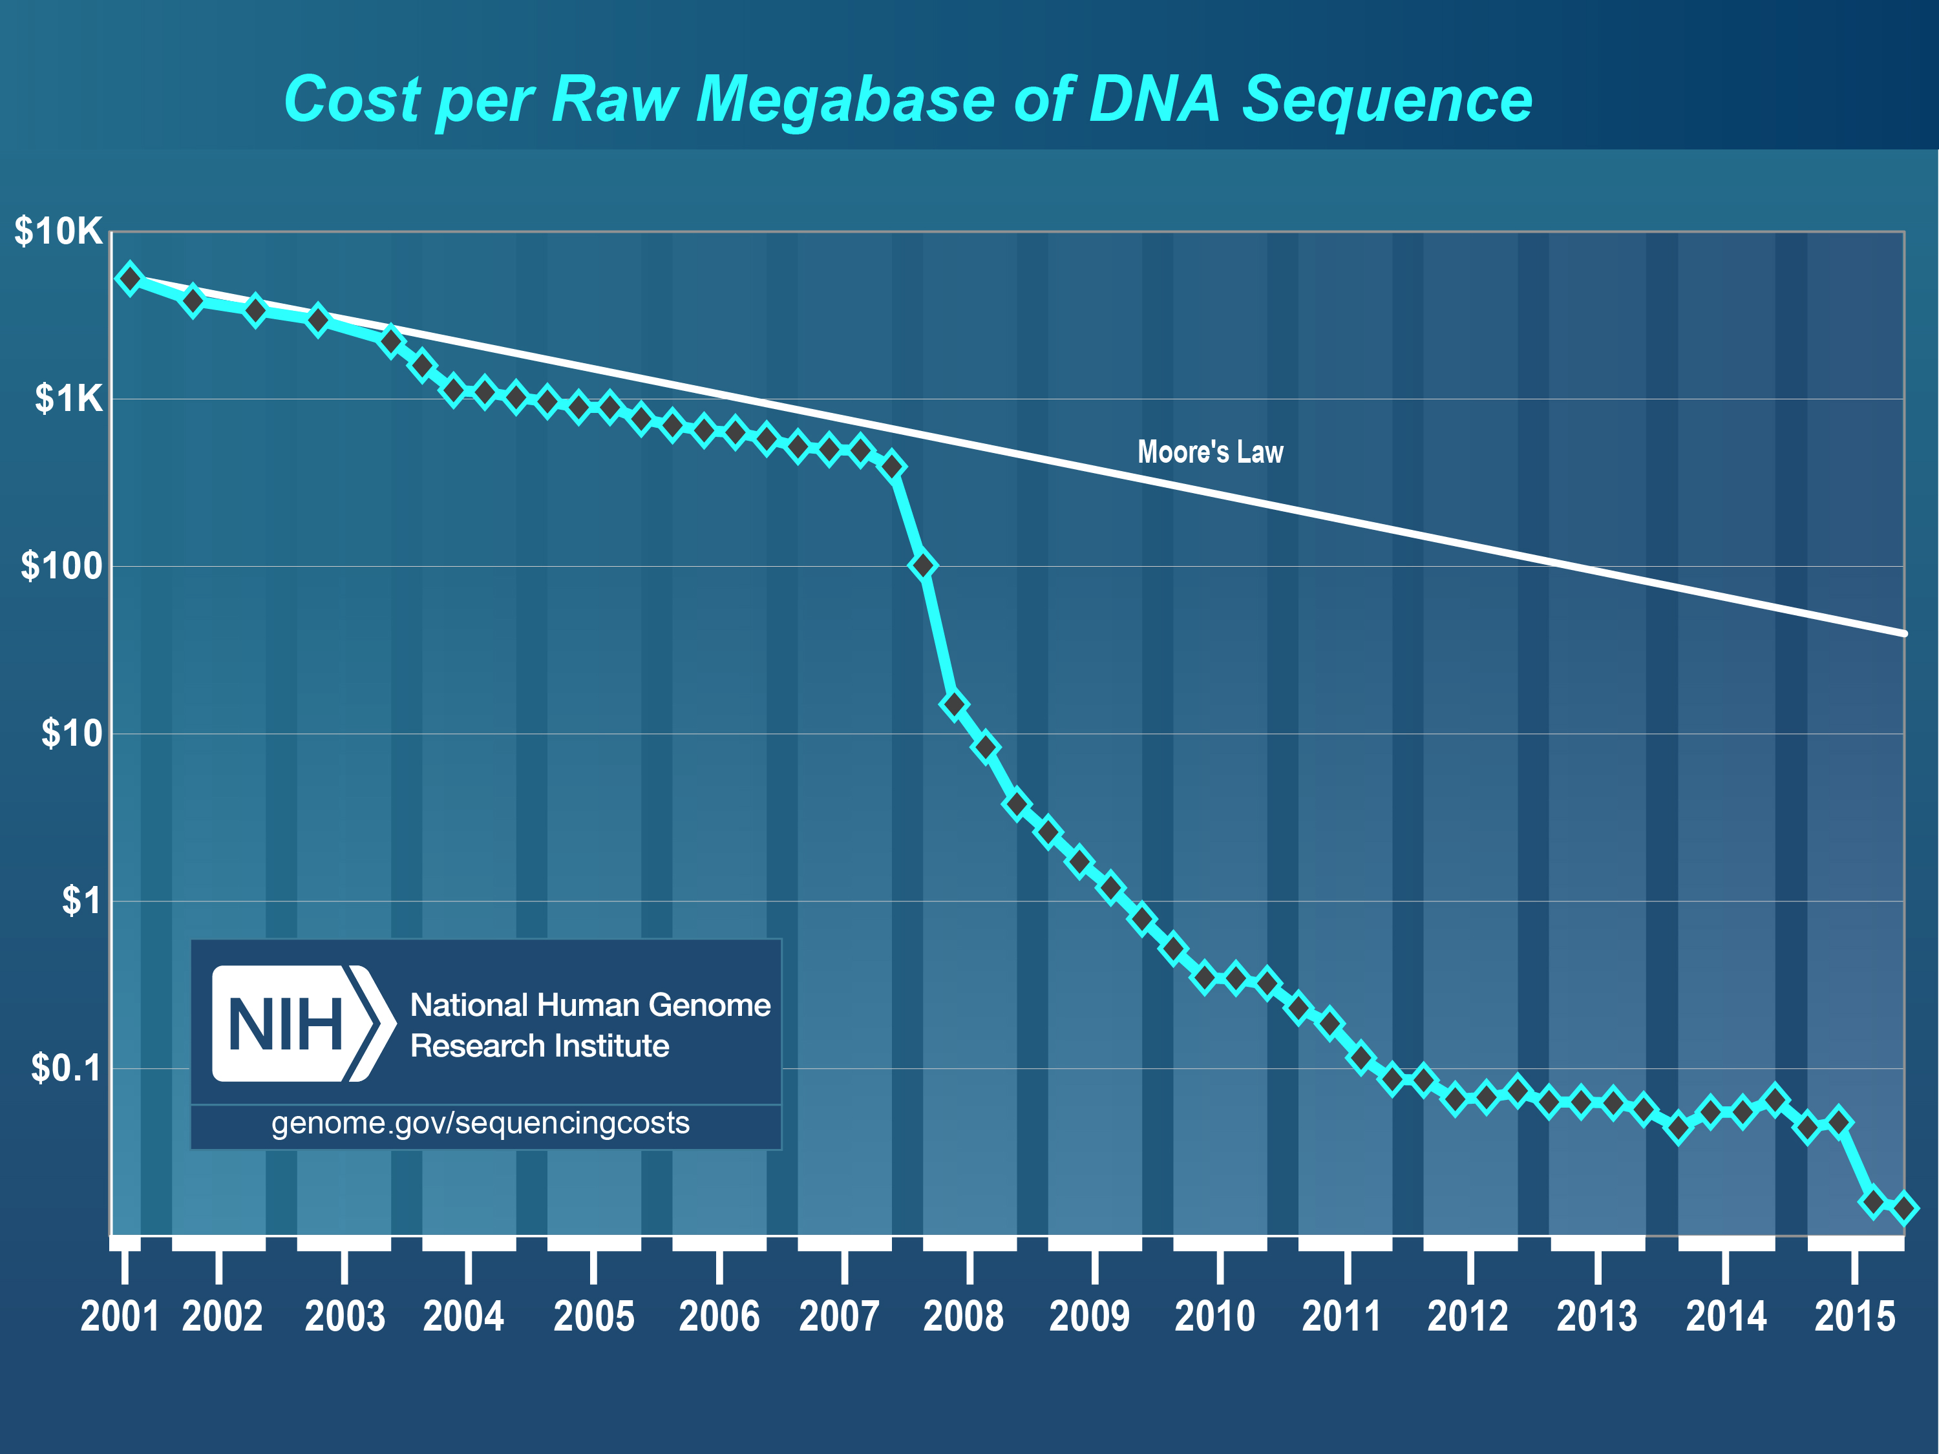
SEQUENCING TECHNOLOGY

Slide 24
SEQUENCING TECHNOLOGY
Third Generation
Direct sequencing
Long reads
Second Generation
“Massively Parallel SBS”
First Generation
“Sequencing by Synthesis”

Slide 25
SEQUENCING TECHNOLOGY
Benefits of Long Read Technology
PacBio and Nanopore can generate reads of 10kb and longer (average is more in the 1-5 kb range)
PacBio increasingly used to:
Detect/resolve “difficult” regions
Assemble genomes of non-model organisms
Nanopore is compact, “real time” – increasingly used “in the field”
Soon will be possible to sequence RNA directly (i.e. without cDNA conversion)

Slide 26
SEQUENCING TECHNOLOGY
(Current) Drawbacks of Long-Read Technology
More expensive (but rapidly dropping)
Higher error rates; however:
These are also rapidly dropping
PacBio errors are random and thus correctable; software-corrected accuracy > 99%
Less tool support (but rapidly increasing)

Slide 27
SEQUENCING TECHNOLOGY
So which should I use?
At least for today, the answer is almost always Illumina

Slide 28
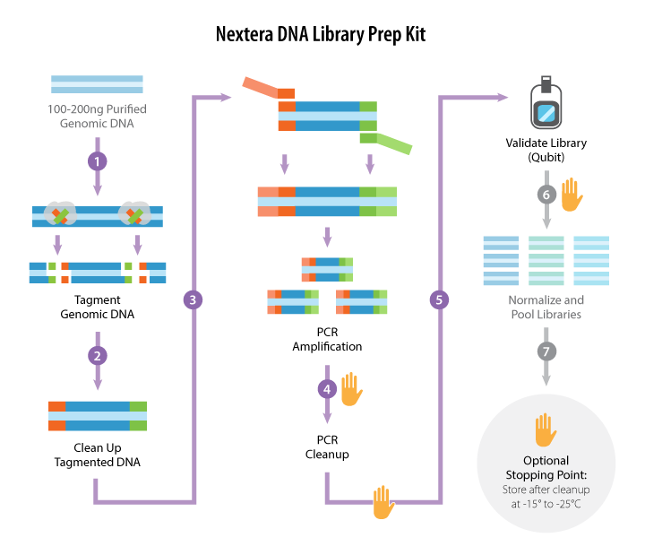
ILLUMINA DNA LIBRARY PREPARATION
Option 1: Nextera (e.g. “Tagmentation”)
https://www.abmgood.com/

Slide 29
ILLUMINA DNA LIBRARY PREPARATION
Option 1: Nextera (e.g. “Tagmentation”)
Fast: 1.5 hr total time, 15 min hands-on
Inexpensive
Low DNA input requirement (50 ng)
High-throughput: indexed adapters available in 96 well format
Potential for bias:
PCR
Transposase insertion

Slide 30
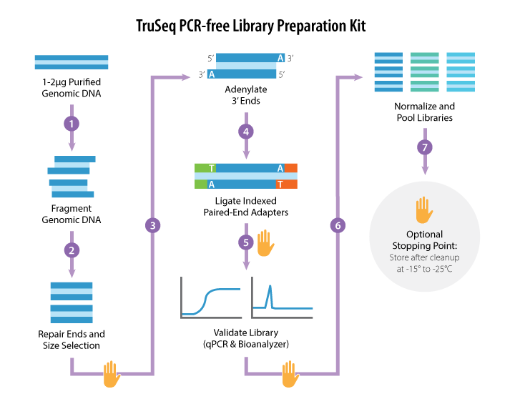
ILLUMINA DNA LIBRARY PREPARATION
Option 2: TruSeq PCR-free
https://www.abmgood.com/

Slide 31
ILLUMINA DNA LIBRARY PREPARATION
Option 2: TruSeq PCR-free
Less potential for bias
Fewer duplicate reads, can reduce sequencing requirements by ~40%
Larger input DNA requirement (1-2 ug)
More expensive (~3x), complex, time-consuming
qPCR or MiSeq run required to validate libraries

Slide 32
ILLUMINA DNA LIBRARY PREPARATION
Synthetic Long Reads
Paired-end sequencing of long inserts
Used for:
Cheaper genome assembly
Genome phasing (i.e. resolving haplotypes)
Resolving large structural variants
Three options:
Manual: TruSeq long-read, Nextera mate-pair
Automated: 10X Chromium
Outsourced: Dovetail Genomics

Slide 33
ILLUMINA DNA LIBRARY PREPARATION
Multiplexing
Each library is tagged with an index
Often, paired-end libraries are tagged with two indexes – one on each end
Libraries are pooled prior to sequencing
Increases the number of libraries you can sequence in parallel
Multiplexing is one of the most important things you can do to increase data quality

Slide 34
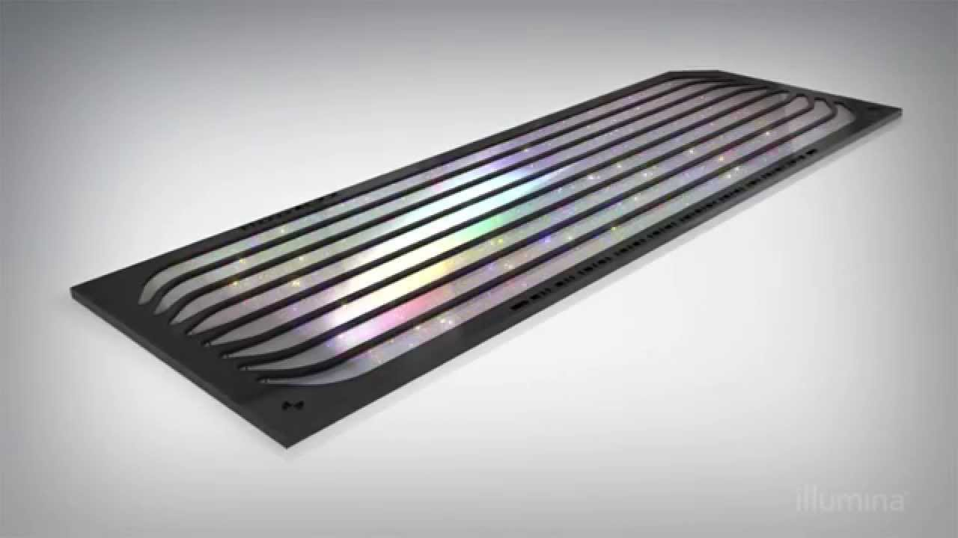
ILLUMINA DNA SEQUENCING
Illumina Flow Cell

Slide 35
ILLUMINA DNA SEQUENCING
Single end (SE) versus paired end (PE)
PE is currently most common, and almost always the best choice
Read pair information significantly improves alignment accuracy
Short fragment sizes can be used to generate redundant sequences – useful when variant frequency near/below level of sequencing error
Exceptions include miRNA-seq (very short fragments)

Slide 36
ILLUMINA DNA SEQUENCING
Read length (50-250 bp)
Key considerations:
Size and frequency of repeats in the genome?
What is expected divergence from the reference?
For variant calling in humans, PE 125 or 150 bp on HiSeq 2500/3000/4000/X is standard
For small highly variable organisms (e.g. E. coli), PE 250 bp on MiSeq
C. Elegans has much lower rate of intergenic/repetitive DNA: shorter reads and even SE acceptable

Slide 37
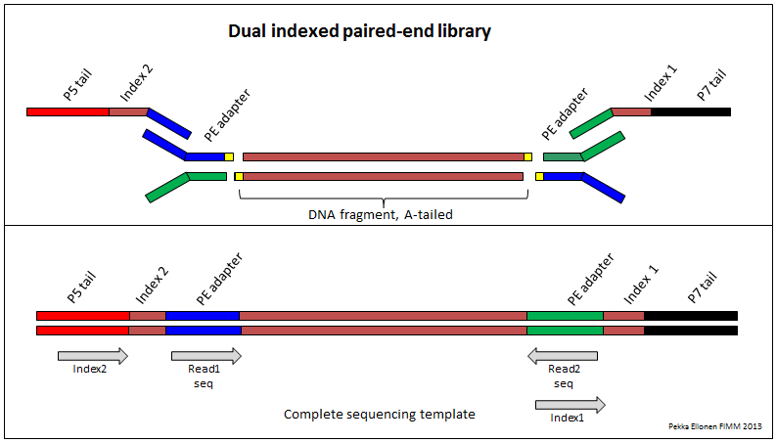
SEQUENCING DATA ANALYSIS
Anatomy of an Illumina Sequencing Read
5’
5’
5’
5’

Slide 38
SEQUENCING DATA ANALYSIS
What do I get from the Genomics Core?
Bases are called using Illumina software
For each read, the software reports:
A sequence of R bases (A/C/G/T/N), where R is the read length
A sequence of R quality scores, where each score is the probability that the corresponding base call is incorrect
Often, libraries will be de-multiplexed into one file (or set of files) per library
Data will be in one of two formats: FASTQ or SAM/BAM

Slide 39
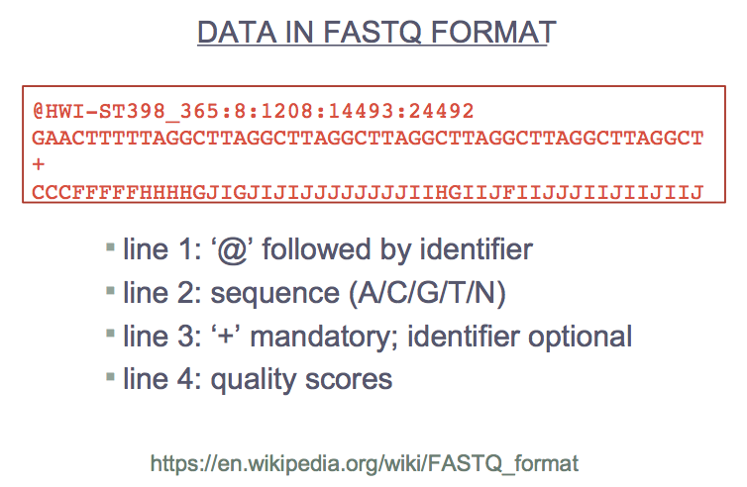
SEQUENCING DATA ANALYSIS

Slide 40
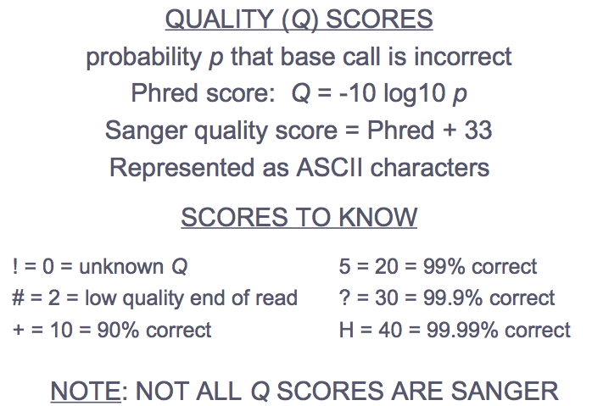
SEQUENCING DATA ANALYSIS

Slide 41
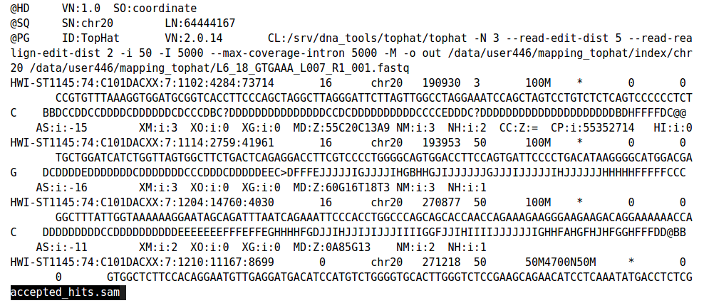
SEQUENCING DATA ANALYSIS
Data in SAM/BAM format

Slide 42
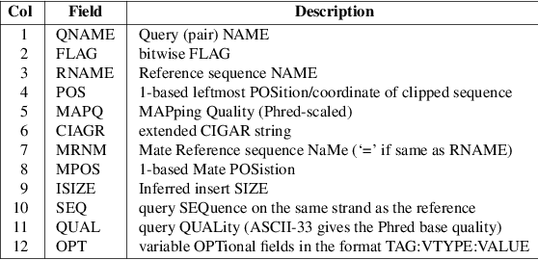
SEQUENCING DATA ANALYSIS
Data in SAM/BAM format

Slide 43
SEQUENCING DATA ANALYSIS
Data in SAM/BAM format
Raw data in SAM/BAM format will be missing most fields (“*” or “0”) except read name, flag, sequence, and qualities
Read pairs will most likely be together, read 1 followed by read 2; if not you will need to sort the reads by name
You may need to convert to FASTQ (e.g. Picard SamToFastq)

Slide 44
VARIANT CALLING WORKFLOW
Experimental design
Library preparation and Sequencing
Data quality
Trimming
Alignment
Variant calling
Annotation
Structural variants (SVs)

Slide 45
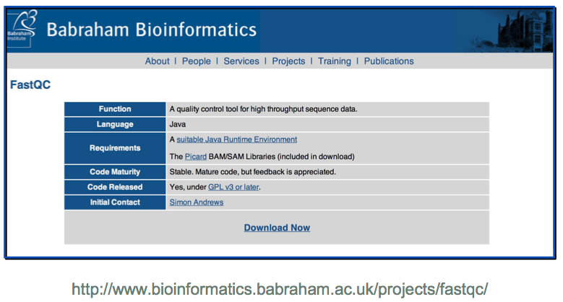
DATA QUALITY
TOOL: FASTQC

Slide 46
DATA QUALITY
Exercises
Launch FASTQC graphical user interface (GUI) using X2GOClient
Navigate to File > Open and select dataset
Start with input/fastqc_dataset_1: high quality WGS

Slide 47
DATA QUALITY
Exercises
We’ll walk through the first report together
Full help documentation at:
http://www.bioinformatics.babraham.ac.uk/projects/fastqc/Help/

Slide 48
DATA QUALITY
Common Issues
Non-random nucleotide composition, especially in the first ~13 bp at 5’ end
Degraded quality at 3’ ends of reads
Adapter contamination (“read-through”)
Adapter dimers
PCR duplicates

Slide 49
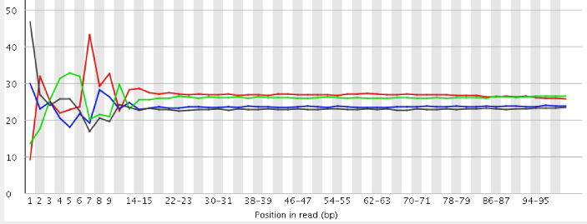
DATA QUALITY
Non-random Nucleotide Composition
Mostly affects RNA-seq and Nextera libraries
Cause is somewhat mysterious – probably due to polymerase/transposase biases
Cannot be corrected, but doesn’t seem to affect downstream analysis

Slide 50
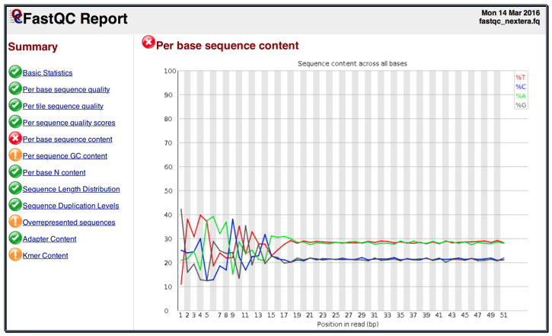
DATA QUALITY
Nextera Example

Slide 51
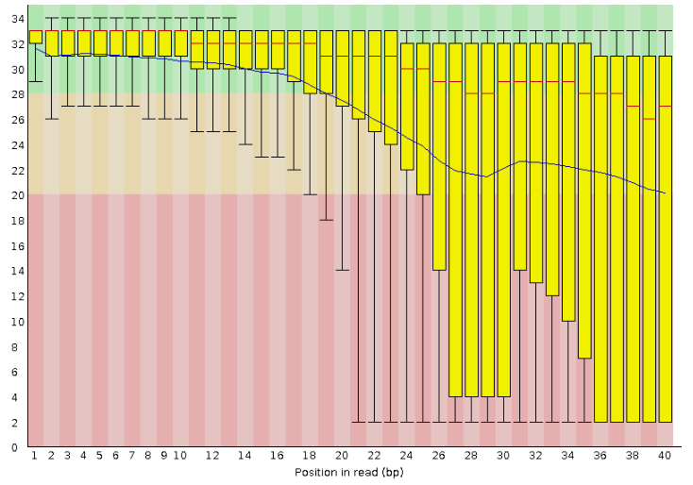
DATA QUALITY
Degraded Quality

Slide 52
DATA QUALITY
Degraded Quality
Mean quality drops below some threshold (30)
Commonly happens at 3’ end of read – especially longer read lengths; this is because the fidelity of the sequencing chemistry degrades with distance
Can be corrected by quality trimming (Step 4); whether necessary depends on your experiment
Can also arise from sequencer issues
In extreme cases, it may be necessary to re-sequence the library; the sequencing core should catch these

Slide 53
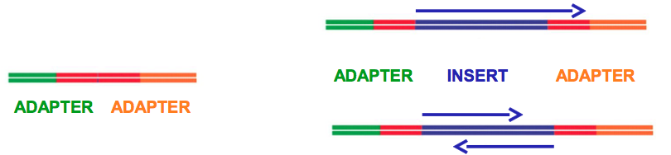
DATA QUALITY
Adapter Contamination
When insert size is shorter than read length, the sequencer reads past end of the insert into the opposite-end adapter
Largely corrected by adapter trimming (Step 4)
Adapter dimers occur when adapter pairs ligate to each other rather than inserts
Not possible with libraries prepared by tagmentation
Easily eliminated by adapter trimming (Step 4)
Large-scale issues usually detected during library QC
Adapter read-through
Adapter dimer

Slide 54
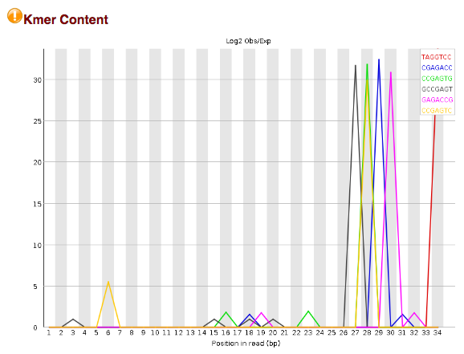
DATA QUALITY
Adapter Contamination

Slide 55
DATA QUALITY
PCR (or “Optical”) Duplicates
Sequencing multiple copies of the same DNA fragment
Detected as multiple reads with identical sequence
Can cause variant calling errors
We will mark duplicates in our alignment pipeline, and the variant caller will ignore them
Reads from highly repetitive regions will also show up as duplicates; eliminating these is fine, as repetitive regions are typically excluded from variant calling

Slide 56
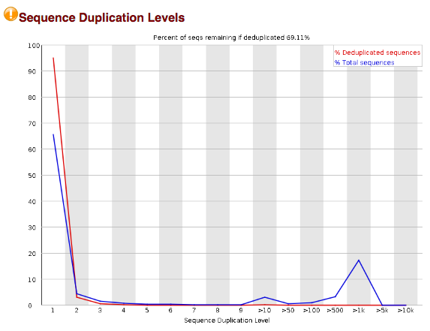
DATA QUALITY
PCR (or “Optical”) Duplicates

Slide 57
DATA QUALITY
Less Common Issues
Sample swaps
Identified by independent genotyping (e.g. sequencing replicate, microarray)
Cross-contamination
Same species: will show up as many “impossible” allele frequencies (0.25, 0.75)
Different species: large fraction of unmappable reads, significantly different GC content
“Weird” quality profiles
Dip in quality in beginning or middle of read
Tile failures
Due to transient sequencer issues, flow cell “bubbles”

Slide 58
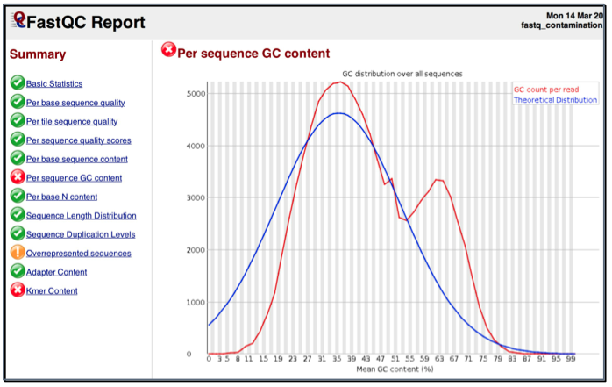
DATA QUALITY
Microbial Contamination

Slide 59
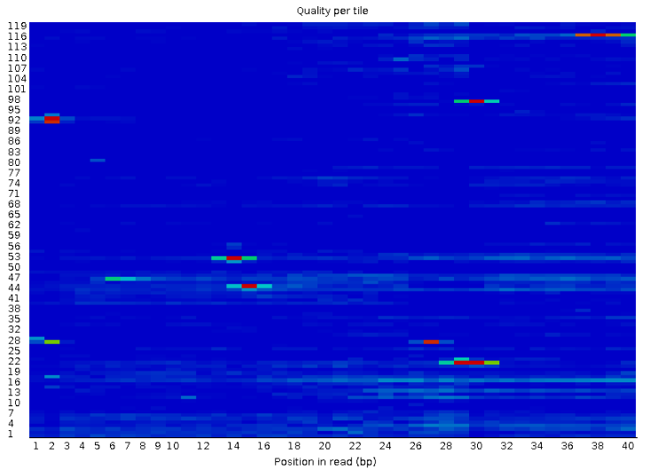
DATA QUALITY
Tile Failures

Slide 60
DATA QUALITY
Review FASTQC Reports for Additional Datasets
dataset_2: low quality WGS
dataset_3: adapter dimers
dataset_4: short inserts, high duplication

Slide 61
INTERLUDE: THE COMMAND LINE
Conventions
# Comments preceded by hash
$ Command prompt starts with a dollar sign
VARIABLES_UPPERCASE_ITALICS
Single line command continued \
onto next line by a backslash

Slide 62
INTERLUDE: THE COMMAND LINE
Moving Around the Filesystem
# what directory am I in now?
$ pwd
# navigate to where the example files live within
# your home directory
$ cd ~/Desktop/variant
# what files are in the current directory?
$ ls –la # -l (long mode), -a (show .files)
# view contents of a file
$ less FILENAME # page through file
$ head -N FILENAME # show first N lines
$ tail –N FILENAME # show last N lines

Slide 63
INTERLUDE: THE COMMAND LINE
More Useful Commands
# <tab> to auto-complete current command
# <up arrow> and <down arrow> to see previous commands
# <Ctrl-r> to search previous commands
# cat concatenates two or more files
# | sends output of one command to another command
# wc -l counts the number of lines
# > sends command output to a file
$ cat FILE1 FILE2 | wc –l > FILE
# read the manual for a command
$ man COMMAND
Homework: learn about grep

Slide 64
INTERLUDE: THE COMMAND LINE
Running FASTQC via Command Line
# see all FASTQC options
$ fastqc -h
# find the path to FASTQC_DATASETS
$ find . –iname ‘fastqc_dataset*’
# create an output directory
$ mkdir output
# run FASTQC – report will be written in output;
# use -t if you have multiple cores
$ fastqc -o output FASTQ.1 FASTQ.2
# if you want to kill the job
$ <Ctrl-C>

Slide 65
VARIANT CALLING WORKFLOW
Experimental design
Library preparation and Sequencing
Data quality
Trimming
Alignment
Variant calling
Annotation
Structural variants (SVs)

Slide 66
TRIMMING
Purpose of Trimming
Remove adapter sequences
Remove low-quality bases
Most trimmers can also filter out undesired reads, e.g. too short
For paired-end reads, if one end is considered undesirable, then both are filtered out

Slide 67
TRIMMING
Skewer
Fast
Specific adapter trimming (i.e. does not remove many non-adapter bases)
Performs error correction
Not as sensitive as other trimmers
Not as feature-rich as other trimmers
Doesn’t seem to scale well
https://github.com/relipmoc/skewer

Slide 68
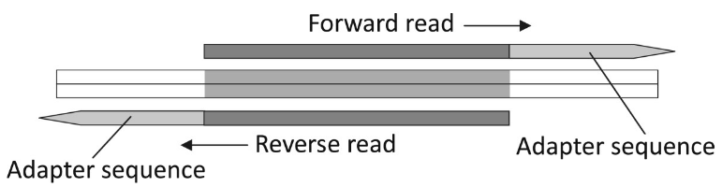
TRIMMING
Skewer Algorithm
Identifies overlap between read-pair
Uses quality information to improve alignment accuracy
For mismatches, replaces lower-quality base
Figure 5, Jiang et al., 2014, BMC Bioinformatics

Slide 69
TRIMMING
Skewer: Important Parameters
-x, -y: specify the adapter sequences
-m: mode; use ‘-m pe’ for paired-end
-r: maximum error rate – default (0.1) is usually fine; set higher (up to 0.3) for lower-quality data
-q: Threshold (Phred-scale) for trimming 3’ end – either don’t use or stick to low values (5 or 10)

Slide 70
TRIMMING
Skewer: Important Parameters (cont.)
-l: minimum read length – shorter reads are filtered out; recommend ‘-l 25’ or more
-n: filter out reads with lots of N’s
-z: compress output files (always recommended)
-t: number of threads to use; not much benefit beyond 8
-o: base name of output file(s)

Slide 71
TRIMMING
Exercise: Adapters Trimming
# perform adapter trimming on dataset_3
$ skewer -m pe -l 25 -n -z -o output/d3raw \
-x resources/adapters/d3.1.fa \
-y resources/adapters/d3.2.fa \
input/dataset3/d3raw.1.fq.gz input/dataset3/d3raw.2.fq.gz
# how many reads did we filter out? Compare:
$ zcat input/dataset_3/d3raw.1.fq.gz | wc –l
$ zcat output/d3raw-trimmed-pair1.fastq.gz | wc –l
# does this match the report from Skewer?
$ cat output/d3raw-trimmed.log
# now run FASTQC on the trimmed files
$ fastqc -o output output/d3raw-trimmed-pair1.fastq.gz \
output/d3raw-trimmed-pair2.fastq.gz
How have Overrepresented Sequences, Adapter Content, and Kmer content changed between the untrimmed and trimmed data?

Slide 72
TRIMMING
Exercise: Adapters and Quality Trimming
# perform adapter and quality trimming on dataset_2
$ skewer -m pe -q 10 -l 25 -n -z -o output/d2raw \
-x resources/adapters/d2.1.fa \
-y resources/adapters/d2.2.fa \
input/dataset_2/d2raw.1.fq.gz \
input/dataset_2/d2raw.2.fq.gz
# check out adapter trimming results in detail:
$ cat output/d2raw-trimmed.log
# now run FASTQC on the trimmed files
$ fastqc -o output FASTQ-trimmed.1 FASTQ-trimmed.2
How have the quality profiles changed between the untrimmed and trimmed data?

Slide 73
VARIANT CALLING WORKFLOW
Experimental design
Library preparation and Sequencing
Data quality
Trimming
Alignment
Variant calling
Annotation
Structural variants (SVs)

Slide 74
ALIGNMENT
Functions of an Alignment Tool
Identify the most likely reference genome coordinate(s) (chromosome, position, and strand) from which each fragment originated
Determine the sequence differences between each read and the reference genome
Calculate a probability that each alignment is correct (mapping quality score)

Slide 75
ALIGNMENT
Mismatches
CGGAAGTTC reference
CGGAGGTTC sample

Slide 76
ALIGNMENT
Mismatches
CGGAAGTTC
CGGAGGTTC
Insertions
CGGAA-GTTC
CGGAACGTTC

Slide 77
ALIGNMENT
Mismatches
CGGAAGTTC
CGGAGGTTC
Insertions
CGGAA-GTTC
CGGAACGTTC
Deletions
CGGAAGTTC
CGGAA-TTC

Slide 78
ALIGNMENT
Mismatches
CGGAAGTTC
CGGAGGTTC
Ambiguity
CGGAAGTTC
CGGAA-TTC
Which is more likely? One gap or two mismatches?
Insertions
CGGAA-GTTC
CGGAACGTTC
versus
CGGAAGTTC
CGGAATTC
Deletions
CGGAAGTTC
CGGAA-TTC

Slide 79
ALIGNMENT
Mismatches
CGGAAGTTC
CGGAGGTTC
Complex Variants
CGGAAG-TTC
CGGAGCTTTC
Insertions
or
CGGAA-GTTC
CGGAACGTTC
CGGAAG--TTC
CGGA-GCTTTC
or
Deletions
CGGAAG-TTC
CGGA-GCTTTC
CGGAAGTTC
CGGAA-TTC

Slide 80
ALIGNMENT
BWA (Burroughs-Wheeler Aligner)
Aligns reads to an index of the reference genome created by Burroughs-Wheeler Transform
Three algorithms; BWA MEM is best for reads 70 bp or longer
Uses a “seed-and-extend” strategy
One of the most mature aligners, written by Heng Li (Broad Institute)
http://bio-bwa.sourceforge.net/bwa.shtml

Slide 81
ALIGNMENT
BWA Workflow
Build index (once per reference genome)
Download reference genome in FASTA format
Run bwa index on the reference
Pre-built indexes exist for commonly used references
Align reads using bwa mem
Convert the output from SAM to BAM
Mark duplicate reads
Sort alignments by coordinate
Index the BAM file
We will create a pipeline to perform 2-6 in one step

Slide 82
INTERLUDE: REFERENCE GENOMES
One reference genome for each species
References evolve over time
Errors corrected
Gaps filled in
Alternative (or “alt”) sequences added
For each reference version (or “build”) there is one canonical sequence, but different annotations
Big (annoying) difference: chromosome names
GRC/NCBI: NC000001, NC000002, …, NC000024
UCSC: chr1, chr2, …, chrX, chrY
Ensembl: 1, 2, …, X, Y
Use the same genome/annotation set for entire project

Slide 83
INTERLUDE: REFERENCE GENOMES
The current human genome reference is GRCh38
Maintained by Genome Reference Consortium
Big improvement over previous build (GRCh37/hg19)
First build with alt loci – large haplotypes that differ substantially between individuals or populations
Significantly improve alignment accuracy
BWA is currently the only aligner to support alt loci
Also includes incremental patches to fix specific regions on shorter timeline (months versus years)
All new projects should use GRCh38
Next reference will almost certainly be graph-based

Slide 84
ALIGNMENT
BWA Alignment Pipeline
In addition to BWA, we’ll use two additional tools:
Sambamba: performs common operations on BAM files very quickly (alternative to samtools)
Samblaster: mark duplicates in a “stream” of reads

Slide 85
ALIGNMENT
Exercise: Align Reads
# Test that our tools work
$ bwa mem
$ sambamba view
$ samblaster -h
# Find our input files
$ find input -iname aligner_input*
# Lets look at the command for our pipeline
$ cat scripts/bwa_pipeline.sh

Slide 86
ALIGNMENT
Exercise: Align Reads
bwa_pipeline.sh:
bwa mem -M -t 1 -R $RG $INDEX $FQ1 $FQ2 | \
samblaster -M | \
sambamba view -S -f bam -h -t 1 /dev/stdin | \
sambamba sort -o $BAM.bam -t 1 /dev/stdin && \
sambamba index $BAM.bam && \
sambamba flagstat $BAM.bam

Slide 87
ALIGNMENT
Exercise: Align Reads
# A read group provides information about the sequencing
# library. ID=A unique name for the read group;
# SM=sample ID; PL=sequencing platform; LB=library name;
# PU=platform unit (e.g. flow cell lane). Fields must
# be tab-separated!
MYRG=“@RG\tID:group1\tSM:sample1\tPL:illumina\t
LB:lib1\tPU:lane1”
# Let’s run our pipeline!
$ scripts/bwa_pipeline.sh FASTQ.1 FASTQ.2 $MYRG BAM_FILE

Slide 88
ALIGNMENT
Exploring Alignment Results
# BAM is a binary format. Use ‘sambamba view’ (or
# ‘samtools view’) to view alignments in plain text.
# First, we’ll look at the header:
$ sambamba view –H BAM | less
@HD VN:1.4 GO:none SO:coordinate
@SQ SN:1 LN:249250621
@SQ SN:2 LN:243199373
@SQ SN:3 LN:198022430
...
@RG ID:U0a_A2_L1 PL:illumina PU:1 LB:1 SM:NA12878
@RG ID:U0a_A2_L2 PL:illumina PU:1 LB:1 SM:NA12878
@RG ID:U0a_A_L1 PL:illumina PU:1 LB:1 SM:NA12878
...
@PG ID:GATK PrintReads VN:2.8 number=-1 simplify=false ...
@PG ID:GATK IndelRealigner VN:2.8 LODThresholdForCleaning=5.0 ...

Slide 89
ALIGNMENT
Exploring Alignment Results
# Now we’ll look at the first read pair:
$ sambamba view BAM | head -2
READ.1 99 1 9976 38 130M1I14M3S = 10256 432 CTAACCCTAACCCT... ??;??=@A@?>??>... NM:i:37 AS:i:87 XS:i:87 RG:Z:U3b_A4_L1
READ.2 147 1 10256 28 74M1D13M5D33M2I26M = 9976 -432 AACCCGAACCCTAA... 101./,45@99+5;... NM:i:18 AS:i:70 XS:i:77 RG:Z:U3b_A4_L1
More about SAM/BAM format
Flags (col 2): each bit has a different meaning
This is a common way to compactly encode lots of info

Slide 90
ALIGNMENT
READ.1 99 1 9976 38 130M1I14M3S = 10256 432 CTAACCCTAACCCT... ??;??=@A@?>??>... NM:i:37 AS:i:87 XS:i:87 RG:Z:U3b_A4_L1
READ.2 147 1 10256 28 74M1D13M5D33M2I26M = 9976 -432 AACCCGAACCCTAA... 101./,45@99+5;... NM:i:18 AS:i:70 XS:i:77 RG:Z:U3b_A4_L1
More about SAM/BAM format (cont.)
MAPQ (col 5) is supposed to be a PHRED-encoded probability, but aligners have different ways of computing this; read the documentation
CIGAR (col 6): summary of the alignment
M=match, I=insertion, D=deletion
S=soft-clip: bases ignored, not removed from sequence
H=hard-clip: bases removed from sequence
Contains no information about SNPs!

Slide 91
ALIGNMENT
READ.1 99 1 9976 38 130M1I14M3S = 10256 432 CTAACCCTAACCCT... ??;??=@A@?>??>... NM:i:37 AS:i:87 XS:i:87 RG:Z:U3b_A4_L1
READ.2 147 1 10256 28 74M1D13M5D33M2I26M = 9976 -432 AACCCGAACCCTAA... 101./,45@99+5;... NM:i:18 AS:i:70 XS:i:77 RG:Z:U3b_A4_L1
More about SAM/BAM format (cont.)
Mate info (cols 7-8): gives the location of the next read in the pair
Fragment length (col 9): estimate of the size of the DNA fragment from which the reads originated

Slide 92
ALIGNMENT
READ.1 99 1 9976 38 130M1I14M3S = 10256 432 CTAACCCTAACCCT... ??;??=@A@?>??>... NM:i:37 AS:i:87 XS:i:87 RG:Z:U3b_A4_L1
READ.2 147 1 10256 28 74M1D13M5D33M2I26M = 9976 -432 AACCCGAACCCTAA... 101./,45@99+5;... NM:i:18 AS:i:70 XS:i:77 RG:Z:U3b_A4_L1
More about SAM/BAM format (cont.)
All columns >11 are optional tags; common ones:
AS, XS: scores of best and second-best alignments
MD: mismatch details (this is where you find SNPs)
NM: edit distance to reference (number of mismatches)
RG: read-group ID
Tags starting with X, Y, and Z are “custom”

Slide 93
ALIGNMENT
Exploring Alignment Results
# sambamba has a “mini-language” for filtering SAM
# output. For example, this command shows only properly
# paired reads with MAPQ >= 30:
$ sambamba view \
–F “proper_pair and mapping_quality >= 30” BAM | less
# Look just at reads in a specific region
$ sambamba view BAM chr1:50000-60000 | less
# Look at multiple regions using a BED file, and save the
# result to a BAM file
$ sambamba view –L resources/align/regions.bed \
–f bam BAM > regions.bam
# Count the number of unmapped reads
$ sambamba view -c -F “unmapped” BAM

Slide 94
ALIGNMENT
Exploring Alignment Results
We can also explore alignments interactively
IGV (Broad Institute) is a popular tool for this
Today, we’ll use a text-based viewer in samtools
# Launch the viewer (try with and without REF)
$ samtools tview input/align/aligner_output.bam [REF]
# Look at the available commands
$ ?
# Navigate to a position in the genome
$ g
$ CHROMOSOME:POSITION (try chr1:10000000)

Slide 95
ALIGNMENT
Interpreting Alignment Results
A read (pair) can often align multiple places
The difference between the best and second-best alignment (AS – XS) factors largely in the MAPQ
If there are multiple equally good alignments, BWA will report one at random with a low MAPQ (usually 0)
Highly divergent reads will fail to map
May happen due to variation (esp. structural), contamination, or sequencing errors
Aligners aren’t perfect! If a particular region is important, verify the alignments visually

Slide 96
VARIANT CALLING WORKFLOW
Experimental design
Library preparation and Sequencing
Data quality
Trimming
Alignment
Variant calling
Annotation
Structural variants (SVs)

Slide 97
VARIANT CALLING
Functions of a Variant Caller
Use information from overlapping alignments to identify small loci – from 1 bp up to about the size of the read length – that differ from the reference
Determine the most likely genotype for each sample at each variable locus
Determine the probability that each variant call is correct (quality score)

Slide 98
VARIANT CALLING
FreeBayes
Bayesian variant caller – leverages base quality, alignment metrics, read depth, local sequence context, and population information
Performs haplotype-based calling
Designed to run on many individuals simultaneously
More samples == better accuracy
Sequencing errors detected as unique haplotypes
Performs local realignment across overlapping reads
https://github.com/ekg/freebayes

Slide 99
VARIANT CALLING
Exercise: Call Germline Variants with FreeBayes
# The default settings work well for most
# situations. All we need is the reference and
# the BAM file. We also specify a region to
# call. Special compression (bgzip) is
# needed for VCF output.
$ freebayes –r chr1:10000000-10100000 \
-f resources/Homo_sapiens_assembly38.fasta \
input/germline/germline.bam \
| bgzip > output/variant_calls.vcf.gz
# Index the VCF file
$ tabix output/variant_calls.vcf.gz

Slide 100
VARIANT CALLING
VCF Header
##fileformat=VCFv4.2
##FILTER=<ID=LowQual,Description="Low quality">
##FORMAT=<ID=AD,Number=R,Type=Integer,Description="Allelic depths for the ref and alt alleles in the order listed">
##FORMAT=<ID=DP,Number=1,Type=Integer,Description=”…">
...
##INFO=<ID=AC,Number=A,Type=Integer,Description="Allele count in genotypes, for each ALT allele, in the same order as listed">
##INFO=<ID=AF,Number=A,Type=Float,Description=”…">
…
FILTER: marker that the variant failed a condition
INFO: information given for each variant
FORMAT: information given in each genotype record

Slide 101
VARIANT CALLING
VCF Variant Rows
#CHROM POS ID REF ALT QUAL FILTER INFO FORMAT SAMPLE1 SAMPLE2...
chr1 51479 rs123 T A 3442.03 PASS AC=5;AF=0.404;AN=20 GT:AD:DP:GQ 0/0:14,0:14:42 0/0:2,0:2:6
ID: If variant is known, it’s database ID (e.g. dbSNP)
REF, ALT: the reference and alternate alleles
ALT may contain more than one allele, comma-separated
QUAL: PHRED-scale probability that there is no variant at this site

Slide 102
VARIANT CALLING
VCF Variant Rows
#CHROM POS ID REF ALT QUAL FILTER INFO FORMAT SAMPLE1 SAMPLE2...
chr1 51479 rs123 T A 3442.03 PASS AC=5;AF=0.404;AN=20 GT:AD:DP:GQ 0/0:14,0:14:42 0/1:2,2:4:6
For each sample:
GT: genotype call; 0 is reference, and 1, 2, … are alternate
0/0 is homozygous reference
0/1 is heterozygous
1/1 is homozygous alternate
‘.’ means no call
If there is a ‘|’ rather than ‘/’, the genotype is phased
GQ: PHRED-scale probability that the call is incorrect

Slide 103
VARIANT CALLING
Variant Filtering using VCFLib
FreeBayes emphasizes sensitivity over specificity, leading to many false-positives
Filtering is necessary to reduce false positives
Several ways to filter: read depth, variant quality, strand bias, variant position in read, etc.
VCFLib is by the same author as FreeBayes
Apply multiple filtering criteria
Many other useful tools
https://github.com/vcflib/vcflib

Slide 104
VARIANT CALLING
Exercise: Filter Variants with VCFLib
# filter VCF by minimum variant quality score
$ vcffilter –f “QUAL > 100” VCF_FILE | \
bgzip > output/filtered.vcf.gz
# filter VCF by minimum read depth; add new
# FILTER tag, rather than removing rows
$ vcffilter -A –t “deep” –f “DP > 250” \
VCF_FILE | bgzip > output/tagged.vcf.gz
# summarize the VCFs and compare
$ vcfstats output/variants.vcf.gz
$ vcfstats output/filtered.vcf.gz

Slide 105
VARIANT CALLING
Exercise: Call Somatic Variants with FreeBayes
# We need two BAM files – one from normal
# tissue and one from a matched tumor sample.
$ freebayes –r 1:16899000-16920000 \
-f resources/GRC37-lite.fa \
--genotype-qualities --min-alternate-count 2 \
--pooled-discrete --min-alternate-fraction 0.05 \
input/somatic/normal.bam \
input/somatic/tumor.bam \
| scripts/somatic_filter 1e-5 18 0 \
| bgzip > output/somatic.vcf.gz

Slide 106
VARIANT CALLING
Other FreeBayes Use Cases
# Run on multiple BAMs listed in a file, and
# require >= 5 observations to call variant
$ freebayes -f REF –L BAM_LIST -C 5 \
| bgzip > vars.vcf.gz
# Sometimes, problematic regions of the genome
# can slow down variant calling or cause
# errors. We can exclude these using a
# whitelist. See resources for how to create.
$ freebayes -f REF -t WHITELIST BAM_FILE \
| bgzip > vars.vcf.gz

Slide 107
VARIANT CALLING WORKFLOW
Experimental design
Library preparation and Sequencing
Data quality
Trimming
Alignment
Variant calling
Annotation
Structural variants (SVs)

Slide 108
ANNOTATION
Purpose
Not all variants are equal – some are more relevant to our research than others
Non-coding versus synonymous versus non-synonymous versus missense
Variants may already be associated with disease
Non-coding variants may alter gene expression
Annotation adds information from other sources to our variant call set
Then we can filter by annotations to prioritize variants

Slide 109
ANNOTATION
BCFTools
Another library of generally useful tools for working with VCF files
Included with samtools
In fact, you can combine samtools, mpileup, and bcftools call for an alternate variant calling pipeline
https://samtools.github.io/bcftools/bcftools.html

Slide 110
ANNOTATION
Exercise: Add SNP Annotations with BCFTools
# BCFTools requires a compressed, indexed VCF
# like we have been making. You can use
# BCFTools rather than tabix to make the index
$ bcftools index VCF_FILE.gz
# Add any missing SNP IDs from dbSNP (rs IDs)
$ bcftools annotate -c ID -Oz \
-a resources/annotations.vcf.gz VCF_FILE.gz > \
OUTPUT_VCF.gz
# Compare the annotated and unannotated VCFs
$ zcat VCF_FILE | head
$ zcat OUTPUT_VCF | head

Slide 111
ANNOTATION
BEDTools
Library of tools for working with BED files
BED files define genomic regions
Simplest is 3-column format: CHR\tSTART\tEND
BED coordinates are 0-based; most other formats (BAM, VCF) are 1-based
BEDTools automatically converts between coordinate systems
http://bedtools.readthedocs.io/en/latest/

Slide 112
ANNOTATION
Exercise: Identify Variants in Common
# Intersect two VCF files
$ bedtools intersect -a ANNOTATED.VCF \
-b COMPARE.VCF > INTERSECTION.VCF
# Look at the results
$ less INTERSECTION.VCF
# Remove false-positive variants identified in
# blacklist
$ bedtools subtract -a OUTPUT.VCF \
-b BLACKLIST.VCF > CLEAN.VCF
# Look at the results
$ less CLEAN.VCF

Slide 113
ANNOTATION
ANNOVAR
Apply functional annotations to variants
Gene-based (e.g. coding changes)
Region-based (e.g. conserved regions)
Filter-based (e.g. does variant appear in dbSNP?)
http://annovar.openbioinformatics.org/en/latest/

Slide 114
ANNOTATION
Exercise: Add Gene Annotations with ANNOVAR
# Download ANNOVAR annotations (only required
# once; already done for you)
$ annotate_variation.pl –buildver \
GENOME_VERSION –downdb -webfrom annovar \
refGene REFERENCE_DIRECTORY
# Convert VCF to ANNOVAR format
$ convert2annovar.pl -format vcf4 INPUT.VCF > INPUT.ANNOVAR
# Add annotations
$ annotate_variation.pl --geneanno --buildver \
GENOME_VERSION --dbtype gene INPUT.ANNOVAR \
REFERENCE_DIRECTORY

Slide 115
ANNOTATION
ANNOVAR Output
nonsynonymous SNV IL23R:NM_144701:exon9:c.G1142A:p.R381Q, 1 67705958 67705958 G A comments: rs11209026 (R381Q), a SNP in IL23R associated with Crohn's disease
nonsynonymous SNV ATG16L1:NM_001190267:exon9:c.A550G:p.T184A,ATG16L1:NM_017974:exon8:c.A841G:p.T281A,ATG16L1:NM_001190266:exon9:c.A646G:p.T216A,ATG16L1:NM_030803:exon9:c.A898G:p.T300A,ATG16L1:NM_198890:exon5:c.A409G:p.T137A, 2 234183368 234183368 A G comments: rs2241880 (T300A), a SNP in the ATG16L1 associated with Crohn's disease
nonsynonymous SNV NOD2:NM_022162:exon4:c.C2104T:p.R702W,NOD2:NM_001293557:exon3:c.C2023T:p.R675W, 16 50745926 50745926 C comments: rs2066844 (R702W), a non-synonymous SNP in NOD2

Slide 116
VARIANT CALLING WORKFLOW
Experimental design
Library preparation and Sequencing
Data quality
Trimming
Alignment
Variant calling
Annotation
Structural variants (SVs)

Slide 117
STRUCTURAL VARIANTS
Large (>100bp) insertions, deletions, duplications, inversions, translocations, and complex rearrangements
Alignment-based variant callers not suited to SV calling
Specialized software uses information from “split” reads (parts of the read map to different places) and “discordant” reads (the two ends of a read pair are far apart or on different chromosomes)
SV calling is challenging – different tools don’t agree well; the best strategy is consensus of multiple tools
Long-read data (PacBio, 10X) will improve SV calls

Slide 118
STRUCTURAL VARIANTS
SV Calling with LUMPY
LUMPY is an easy to use SV caller
We have to give LUMPY two additional BAM files: split and discordant reads
There is an alternate BWA pipeline (bwa_pipeline_for_sv.sh) to generate these
https://github.com/arq5x/lumpy-sv

Slide 119
STRUCTURAL VARIANTS
Exercise: Call SVs with LUMPY
# Run LUMPY excluding blacklist regions, and optionally
# specify discordant and split reads:
$ lumpyexpress -B BAM_FILE -D DISC_BAM_FILE \
-S SPLIT_BAM_FILE [-T TEMP_DIR] [-x BLACKLIST.BED] \
-o SVs.VCF
# Examine the output:
$ less SVs.VCF

Slide 120
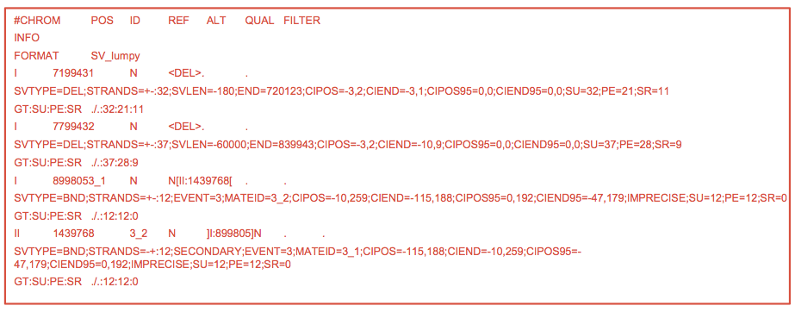
STRUCTURAL VARIANTS
LUMPY Output
Output is VCF, but looks a little different
All the information about the SV is in the INFO field

Slide 121
RECAP
Today’s Pipeline
Data quality: FASTQC
Trimming: Skewer
Alignment: BWA + Sambamba + Samblaster
Variant calling: FreeBayes
Variant quality filtering: VCFLib
Known variant annotation: BCFTools, BEDTools
Mutation annotation: ANNOVAR
Structural Variants identification: LUMPY

Slide 122
ALTERNATIVES
Many Choices for Each Step
Trimming: Atropos, TagDust
Alignment: HiSAT, Novoalign
Variant calling: GATK, GotCloud
Known variant annotation: VCFTools
Mutation annotation: SNPEFF, VEP
Structural Variants identification: GenomeStrip, CNVnator, Delly
Entire pipelines: SpeedSeq, gnko

